Slide 1
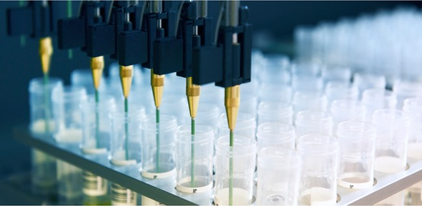
Introduction to Biomarkers
NIBR Hackathon
Rebecca Leary
Next Generation Diagnostics, Oncology Translational Research
Oncology Research, Novartis Institutes for Biomedical Research
August 13, 2019

Slide 2
What are biomarkers?
A measurable indicator of some biological state or condition
Evaluated to examine:
Normal biological processes
Pathogenic processes
Pharmacologic responses to a therapeutic intervention

Slide 3
Mechanism of action biomarkers
Observe modulation of target
Predict drug exposure or metabolism
Monitor drug safety and efficacy
Measure serum LDL cholesterol in patients with hypercholesterolemia to assess response to a lipid-lowering treatment
Pharmacodynamics
Assess CYP2C9 gene variants to predict warfarin metabolism and identify appropriate dosing
Pharmacogenomics
Liver function panels to identify liver toxicities in patients treated with liver-metabolized drugs
Requires understanding drug target, mechanism, metabolism, etc

Slide 4
Biomarkers of disease
Predict disease susceptibility
Detect and diagnose disease
Classify disease subtype
Monitor disease progression
APOE genetic variant and
Alzheimer’s disease
Prostate Specific Antigen (PSA) levels elevated in prostate cancer
Breast cancer subtyping to HR⁺, HER2⁺, or triple negative
Viral load and T cell counts in HIV infections
Requires understanding disease biology and natural history

Slide 5
Types of biomarkers
Physical
Body temperature
Blood pressure
Imaging
CT
MRI
Molecular
DNA
Protein
RNA
PET
Gait

Slide 6
Molecular biomarker approaches
Genotyping (DNA)
DNA sequencing, PCR, FISH
Germline genetics – identify sequence variants present in every tissue
Blood or buccal swab
Somatic genetics – identify sequence variants only present in disease-associated tissue
Biopsy, surgical resection
Expression profiling (RNA or protein)
Expression profiling – microarrays, RNA sequencing, qPCR
Tissue or blood, depending on disease biology
Protein profiling – flow cytometry, immunohistochemistry, ELISA
Tissue or blood, depending on disease biology

Slide 7
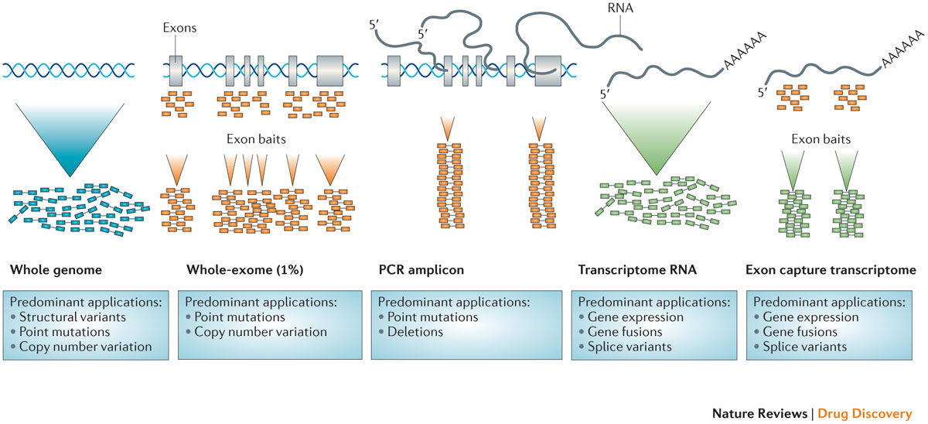
Common sequencing approaches
Simon and Roychowdhury, Nat Rev Drug Discovery. 2013

Slide 8
Biomarker considerations
Access to the measured indicator
Obtaining sample – tissue, biofluid, etc
Obtaining measurement at the right time
Relevance of measurement to biology
Direct vs indirect observation
Method used for measurement provides sensitivity and specificity required for interpretation

Slide 9
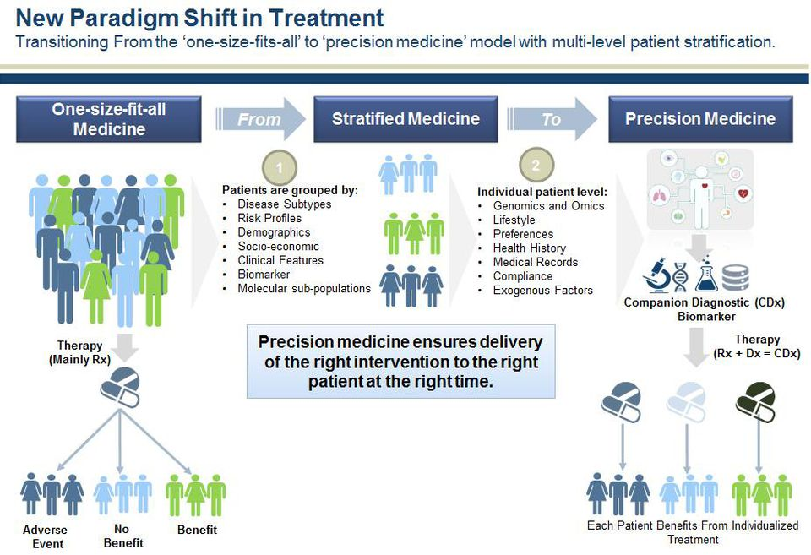
Precision medicine
Das R, Forbes 2017

Slide 10
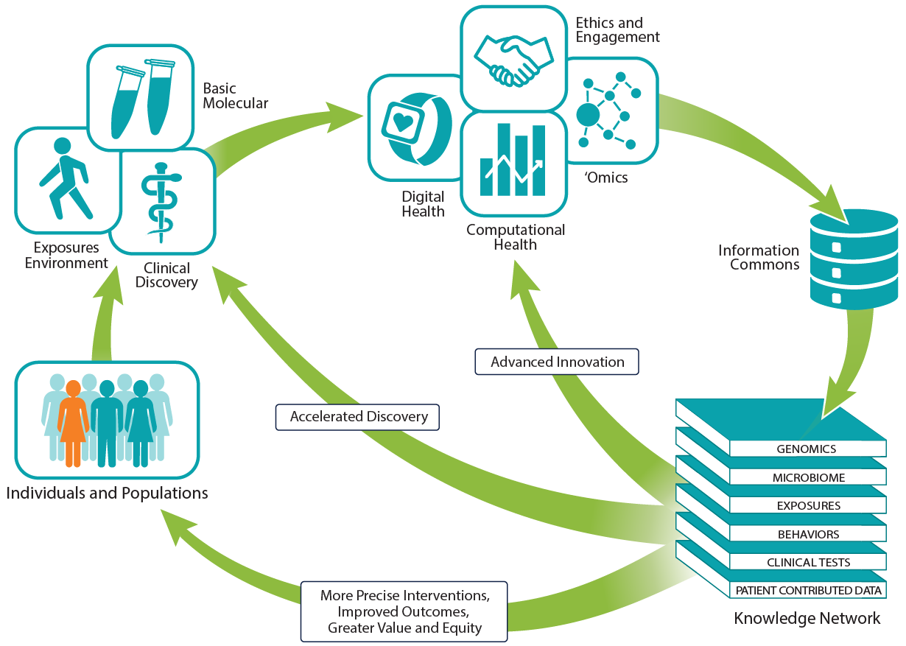
Biomarker innovation
The elements of precision medicine: precisionmedicine.ucsf.edu
Notes:
Findings from basic, clinical, and social/behavioral research, data from digital health, 'omic technologies, and computational health sciences and ethical and legal guidelines are integrated into a knowledge network, creating a sort of "Google maps for health," which informs both science and care for individuals and populations.

Slide 11
Example: approaches for cancer targeted therapies

Slide 12
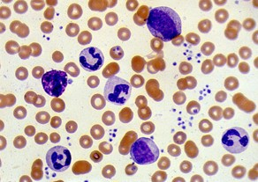
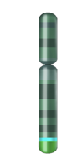


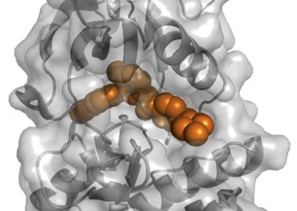


Paradigm shift: targeted therapies
CML
Disease
Chr 9
Chr 22
t9:22
Pathogenesis
BCR-ABL
t(9:22)
BCR-ABL fusion
Imatinib
Target-based drug discovery
Notes:
8/12/2019 2:35 PM
Open_Sellers_V01.ppt
12

Slide 13
The genetic paradigm validated: Dramatic reduction in the mortality from CML since 2001
Imatinib
Nilotinib
CML cases (US)
440
270
Incidence
Mortality
Ca Journal Statistics
Notes:
Open_Epstein_v14
8/12/2019
13

Slide 14
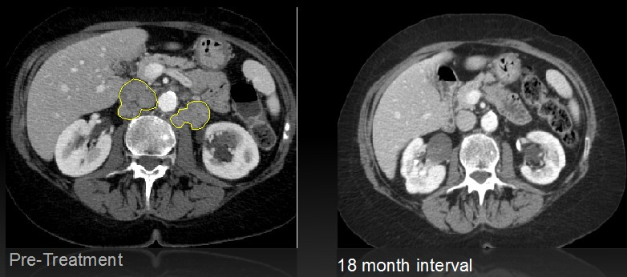
Everolimus in a bladder cancer patient
Iyer et al. Science 2012
73 year old woman with metastatic bladder cancer
Achieved a complete response to everolimus (mTORC1 inhibitor) with no evidence of disease for >20 months
This patient was one of only 2 / 45 patients who responded to the drug
Why?

Slide 15
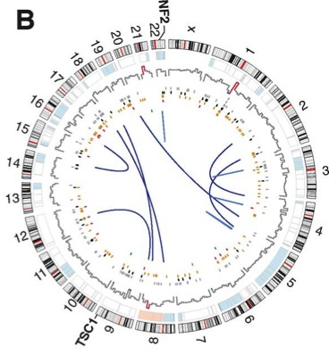
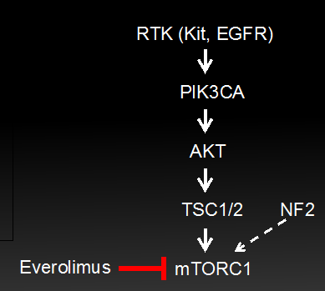
Exceptional responder sequencing
Iyer et al. Science 2012
Whole genome sequencing reveals genetic basis for everolimus sensitivity: coding mutations in TSC1 and NF2

Slide 16
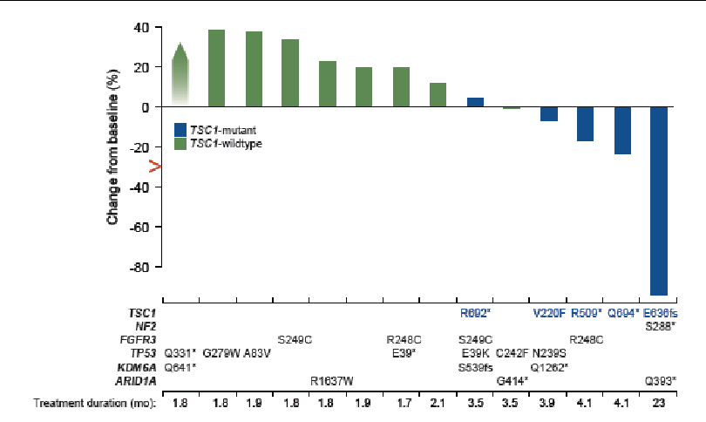
Extrapolated to larger cohort
Iyer et al. Science 2012
Sequencing additional bladder cancer patients revealed that patients with TSC1 mutations had improved response
Everolimus may be more effective in patients with TSC1 mutations
Indicates the important potential benefit of studying exceptional responders
Courtesy of David Solit

Slide 17
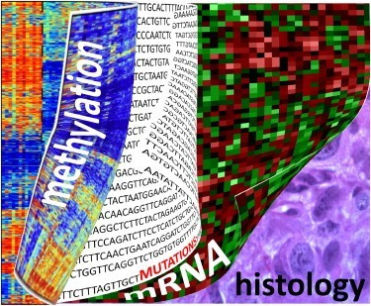

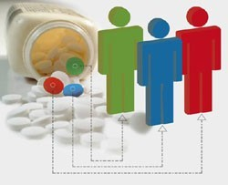
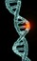
Paradigm shift in cancer diagnostics
Understand tumor genetics and identify rational targets
Create drugs that effectively modulate those targets
Stratify patients to therapy based on individual genetics

Slide 18
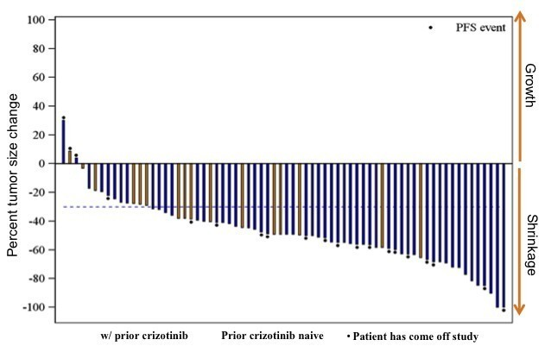
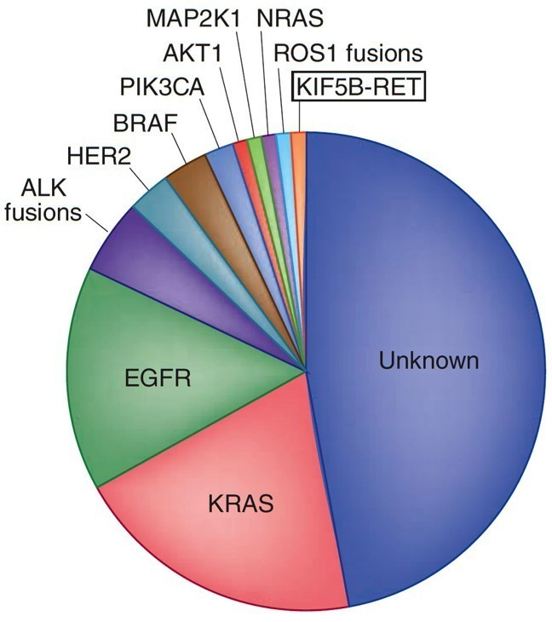
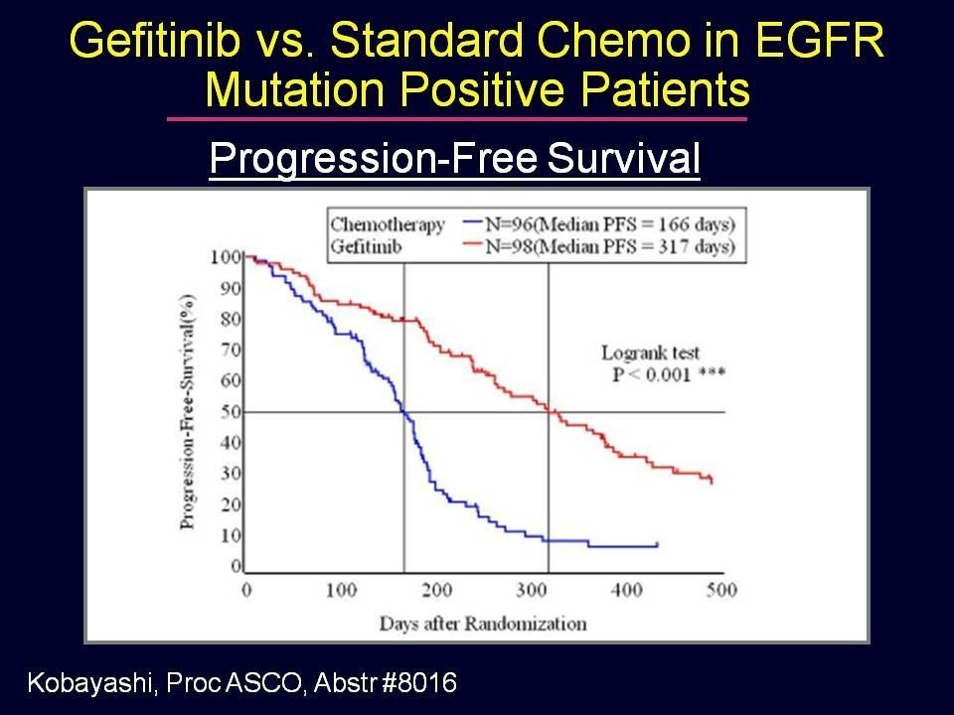
The lung cancer genome
Pao & Hutchinson Nat Med, 2012. Kobayashi, Proc ASCO, 2009. Shaw , et al. ESMO, 2012

Slide 19
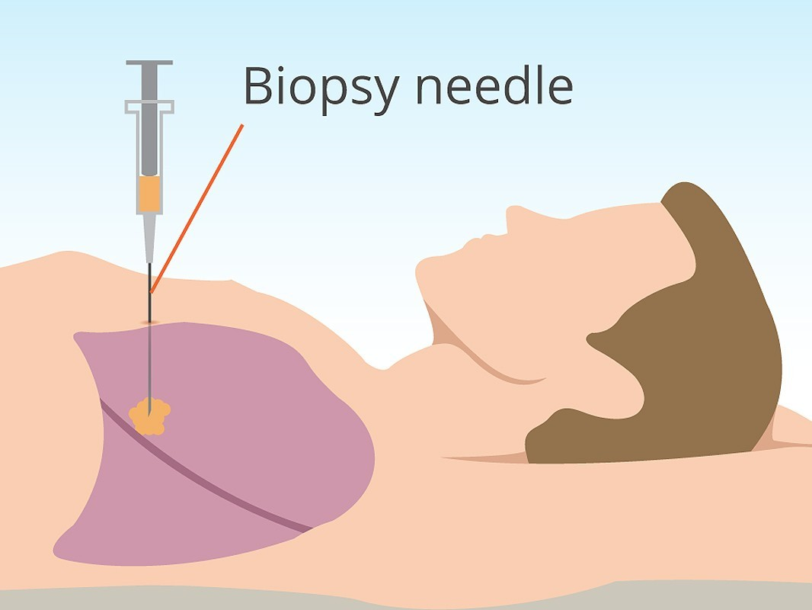
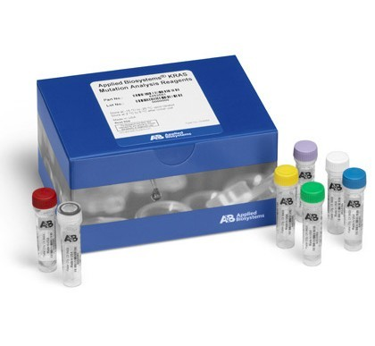
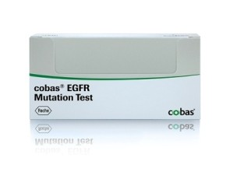
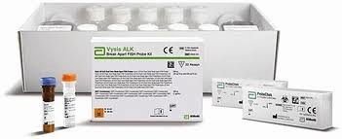
If you were diagnosed with lung cancer today...
KRAS (50ng)
EGFR (150ng)
ALK (~100ng)
19

Slide 20
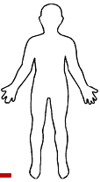
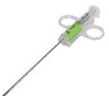
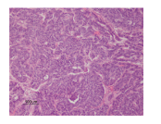
Non-invasive enabling of personalized medicine
Patient sample collection and clinical decision making
Understanding individual tumor genetics to tailor therapies
What is the optimal therapy?
What is the optimal therapy?
Response?
Resistance?
Response?
Resistance?
Challenging to obtain
Frequently exhausted
Stored for years
Poor nucleic acid quality

Slide 21

Non-invasive enabling of personalized medicine
Patient sample collection and clinical decision making
Understanding individual tumor genetics to tailor therapies
What is the optimal therapy?
What is the optimal therapy?
Response?
Resistance?
Response?
Resistance?
Challenging to obtain
Frequently exhausted
Stored for years
Poor nucleic acid quality

Slide 22
Tumor DNA in the circulation
Tumor derived DNA may be identified in total cell free DNA
Spatial heterogeneity → any cell death should release DNA into the circulation
Temporal heterogeneity → blood draws are easy to obtain over the course of patient care
Crowley et al., Nature Reviews Clinical Oncology, July 2013
Notes:
Tumor cell death releases DNA into circulation
Cell free DNA comprised of both tumor and normal material
Somatic events may be used to identify tumor-derived cfDNA

Slide 23
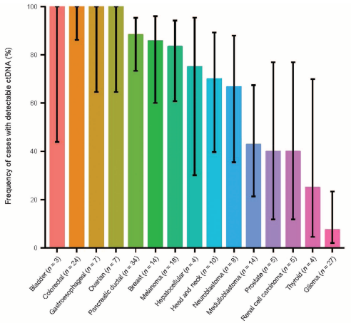
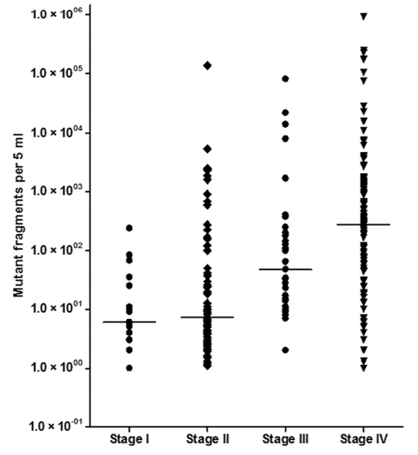
cfDNA assays may be broadly applicable
Evaluation across tumor types and stages
ctDNA frequently detected in many common tumor types
Large range of ctDNA levels, within each tumor type and stage
Bettagowda et al Sci Trans Med, 2014
Notes:
>600 patients from 18 tumors types
Detected in >75% with advanced pancreatic, ovarian, colorectal, bladder, gastroesophageal, breast, melanoma, hepatocellular, head and neck
Detected in 10-40% of primary brain, renal, prostate, or thyroid

Slide 24
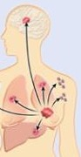
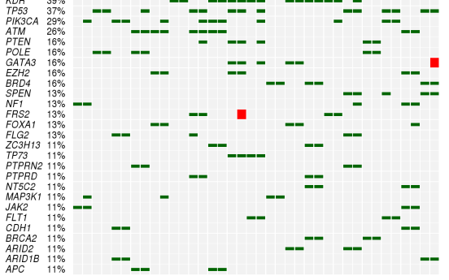
NGDx cfDNA NGS assay
Broad profiling of cancer lesions in cfDNA
At Novartis, we have developed a 600 gene assay to characterize cell-free DNA for translational research
Tumor
Normal DNA
Plasma
Short variant
Tumor DNA
Amplification
600 gene panel
Cancer genes and pathways
SNVs, CNVs, Translocations
Description of mutation landscape
Identification how mutations change over time
Correlate ctDNA with response to therapy
Notes:
Understand how tumor genomes are represented in cfDNA
Elucidate heterogeneity and mechanisms of resistance
Clinical implications of cfDNA assessment

Slide 25
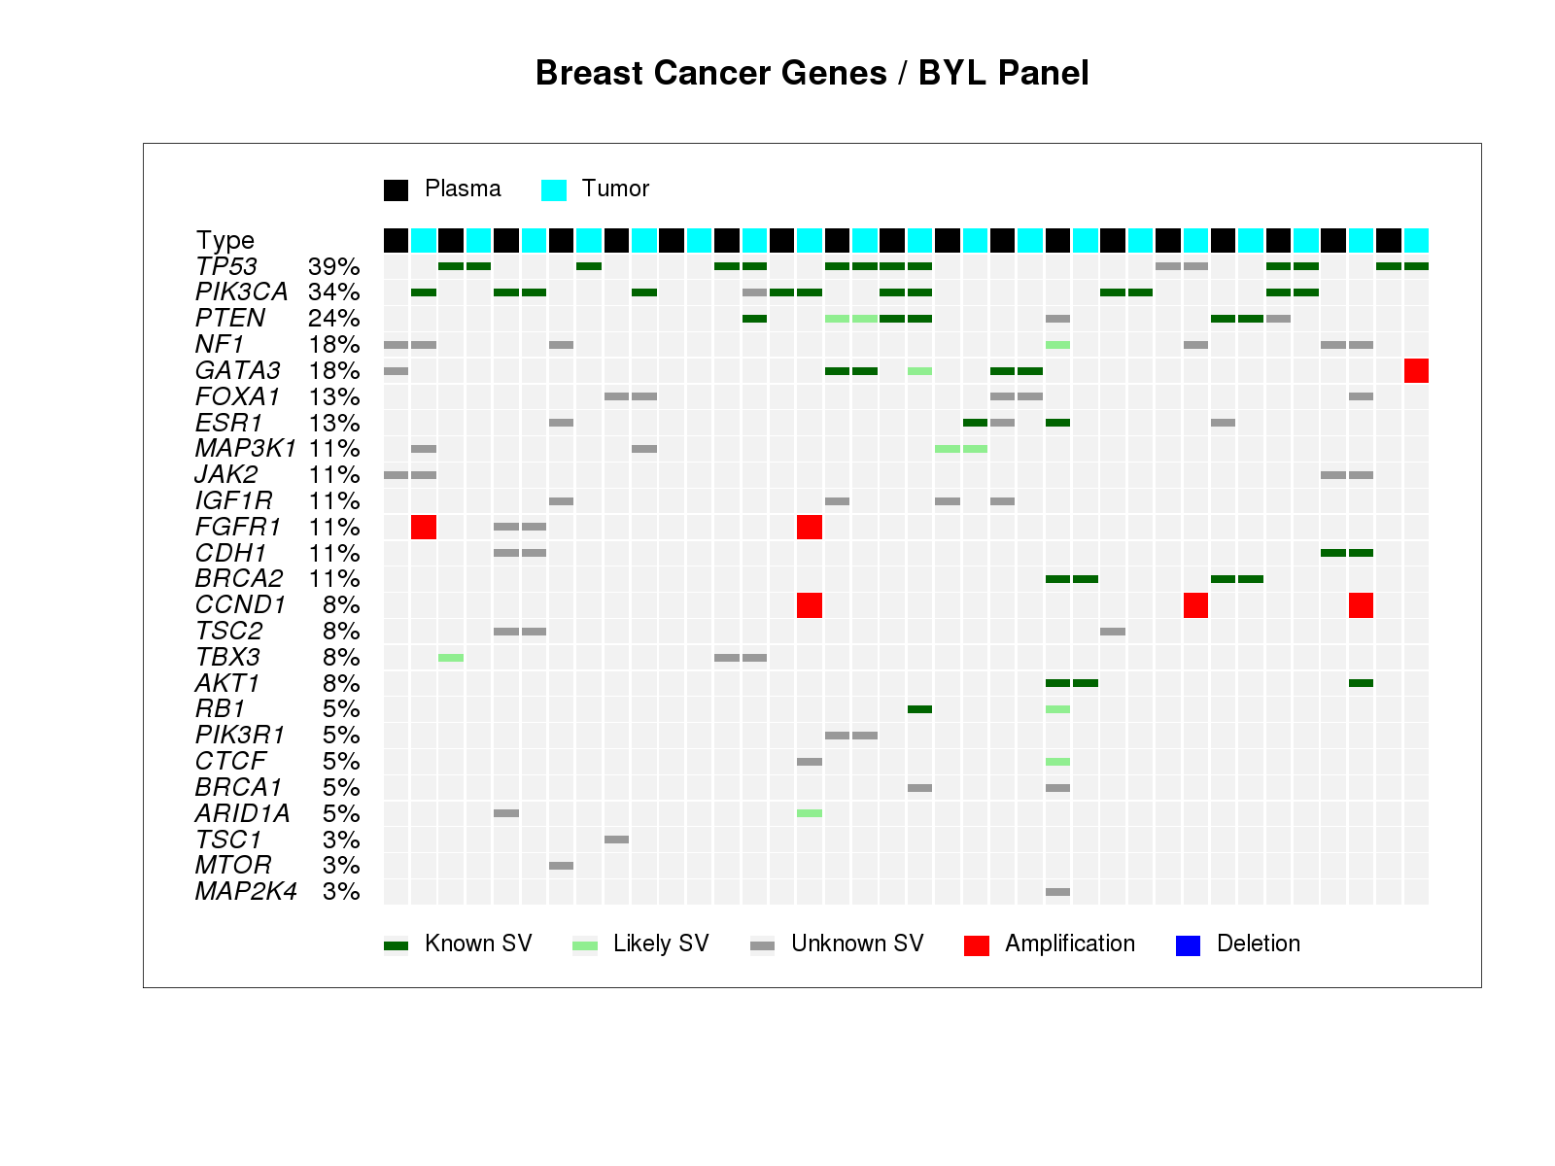
Description of mutation landscape
Plasma-tumor pairs from late stage breast cancer
Notes:
Driver events identified in both plasma and tumor for 14/19 patients

Slide 26
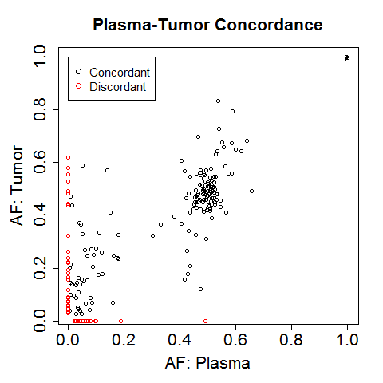
cfDNA reflects changes in tumor over time
Time elapsed between collections | Variants detected in plasma | Detected in tumor
 |  | N | % Agree
All | 64 | 42 | 66
5-15 years | 27 | 11 | 41
<1 year | 37 | 31 | 84
cfDNA has higher concordance with recently collected tumor tissue
Suggests that changes in tumors over time are reflected in cfDNA
Notes:
Concordance of variants with AF < 0.40

Slide 27
Description of mutation landscape
ESR1 has more mutations in plasma than in tumor
K. Polyak, Nature Medicine, 2014

Slide 28
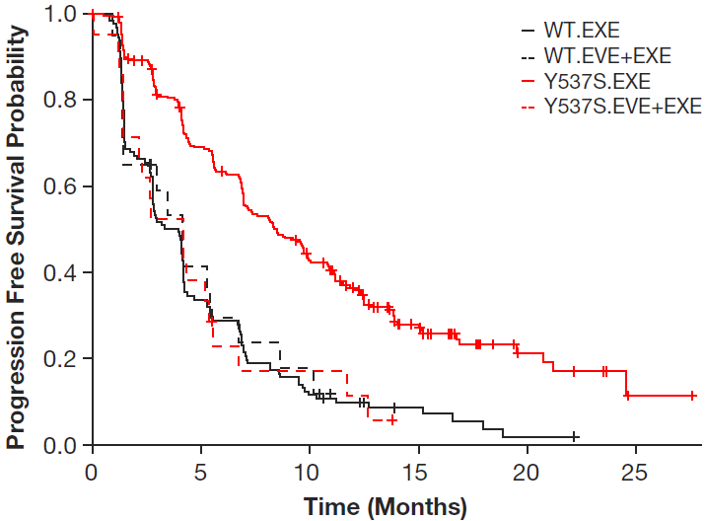
Impact of cfDNA-detected ESR1 Mutations on everolimus treatment
WT EVE+EXE
WT EXE
Y537S EVE+EXE
Y537S EXE
Chandarlapaty et al, SABCS 2015

Slide 29
Monitoring cfDNA during treatment can detect relapse and resistance
Crowley et al., Nature Reviews Clinical Oncology, July 2013

Slide 30
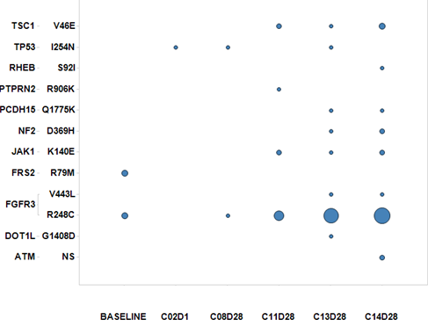
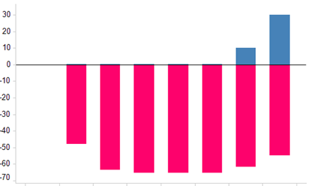
Disease progression detectable in cfDNA prior to CT ...case study using a broad NGS panel
% Change from BL
% Change from Smallest Sum LD
Overall lesion response:
PR PR PR PR PR PR PD
Baseline C3D3 C5D1 C7D1 C8D28 C12D2 C13D28 C14D28
= 100% (are sized by AF)
Recurrence detected in cfDNA up to 20 weeks prior to CT finding

Slide 31
Summary
cfDNA represents an opportunity for temporally-relevant tumor genotyping
cfDNA is promising for understanding drug response and the detection and discovery of resistance mutations
On-treatment monitoring of cfDNA may help us to better understand patient responses and predict relapse
Additional work is required to understand how best to implement across indications and treatments

